Slide 1
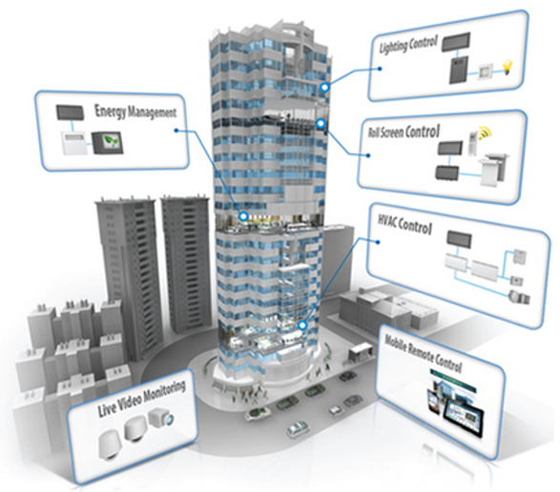
DATA CENTER INFRASTUCTURE MONITORING SYSTEM
DCOSS V.1.

Slide 2

FITUR APLIKASI
Dashboard
Record
Data Master
Management
Setting

Slide 3

DASHBOARD

Slide 4
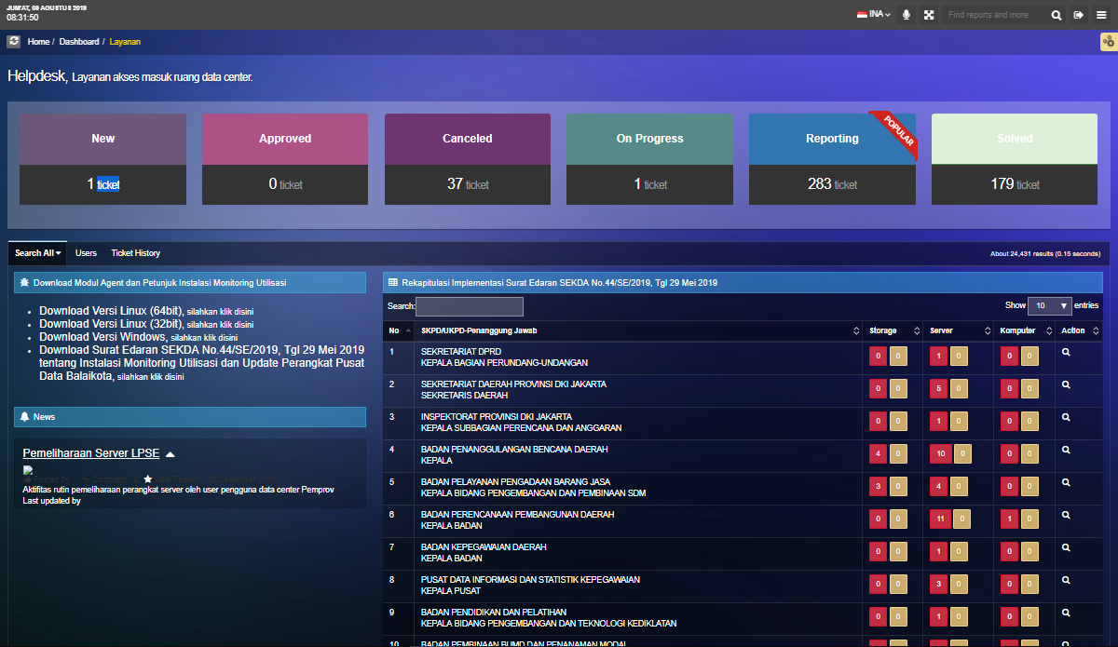
DASHBOARD / LAYANAN

Slide 5
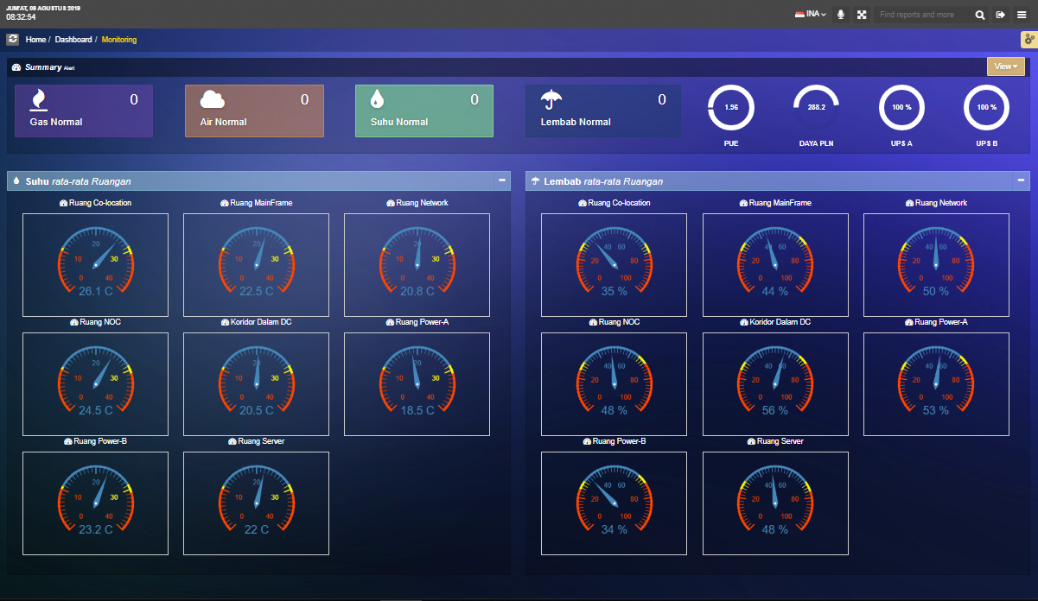
DASHBOARD / MONITORING

Slide 6
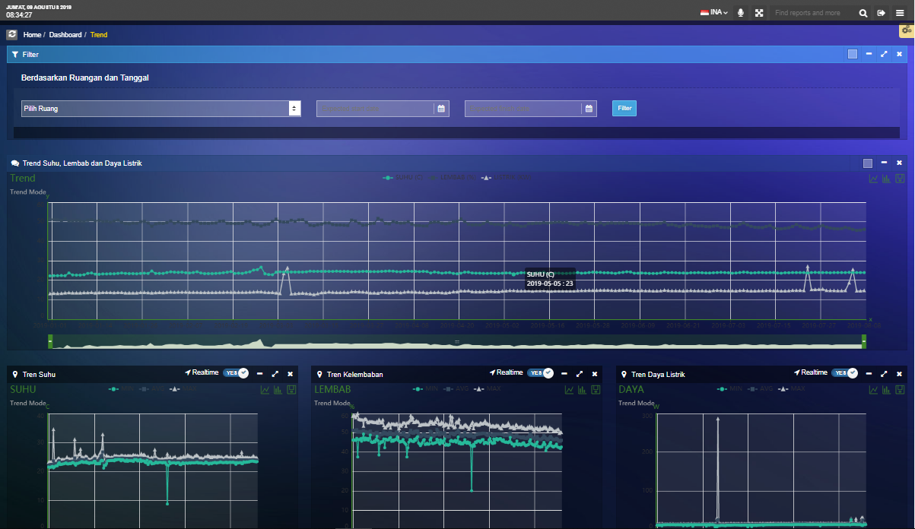
DASHBOARD / TREND

Slide 7
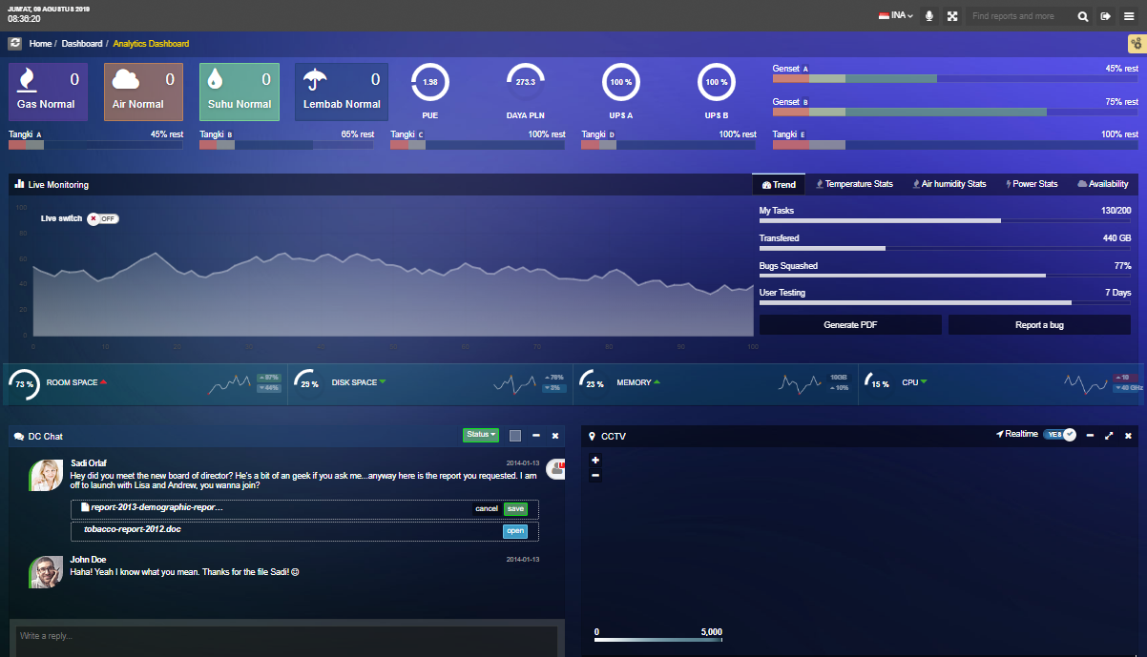
DASHBOARD / ANALYTICS DASHBOARD

Slide 8

MANAGEMENT

Slide 9
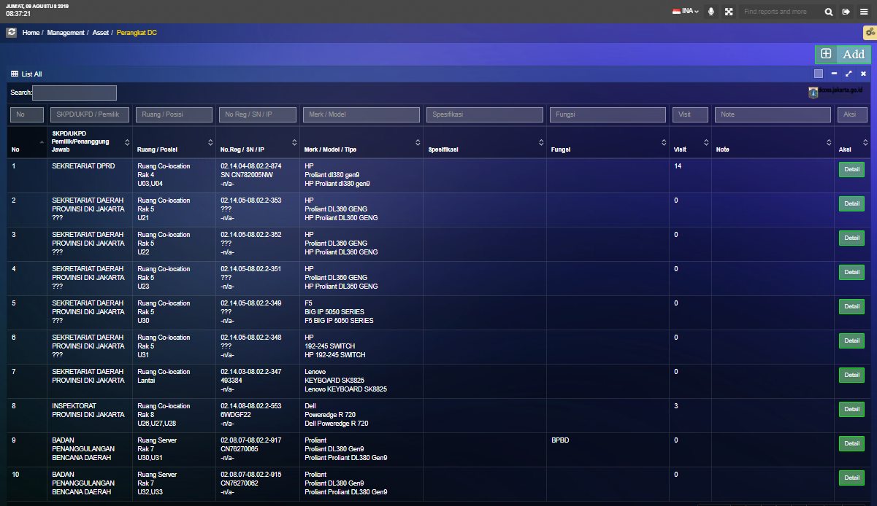
MANAGEMENT / ASSET / PERANGKAT DC

Slide 10
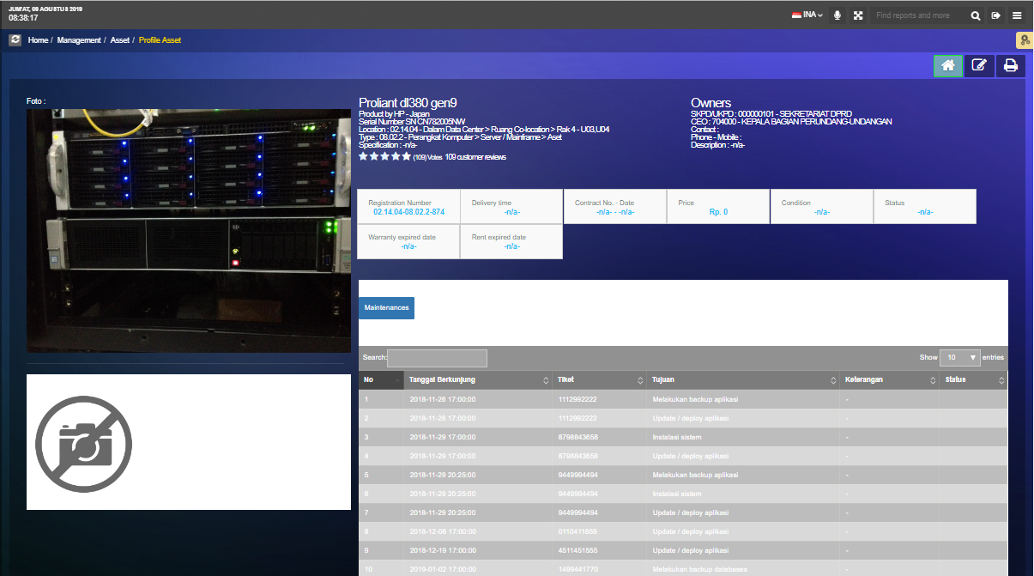
MANAGEMENT / ASSET / PERANGKAT DC / PROFILE ASSET

Slide 11
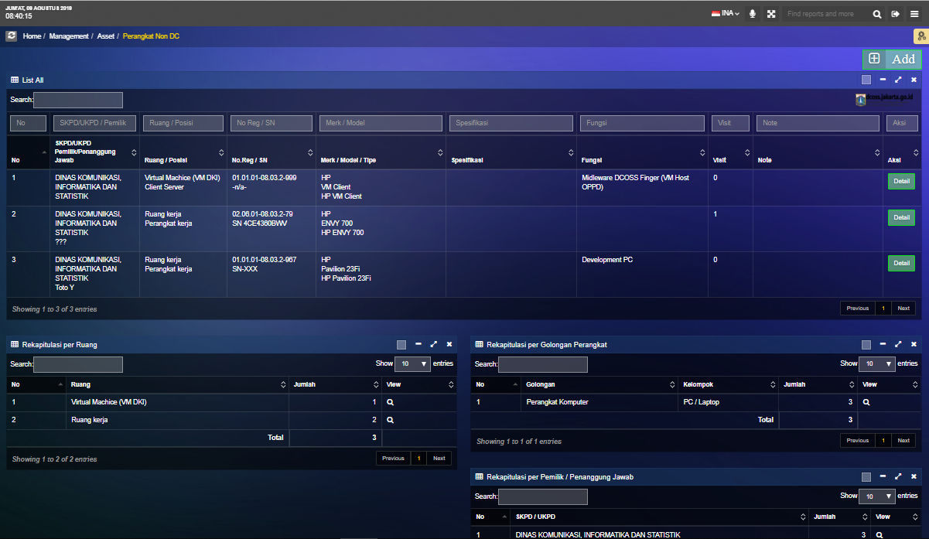
MANAGEMENT / ASSET / PERANGKAT NON DC

Slide 12
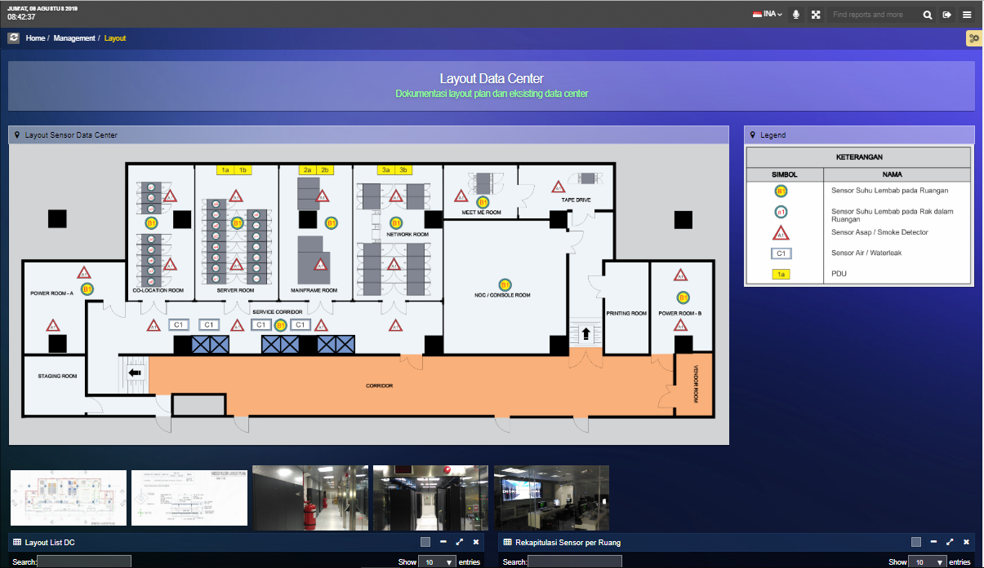
MANAGEMENT / LAYOUT

Slide 13
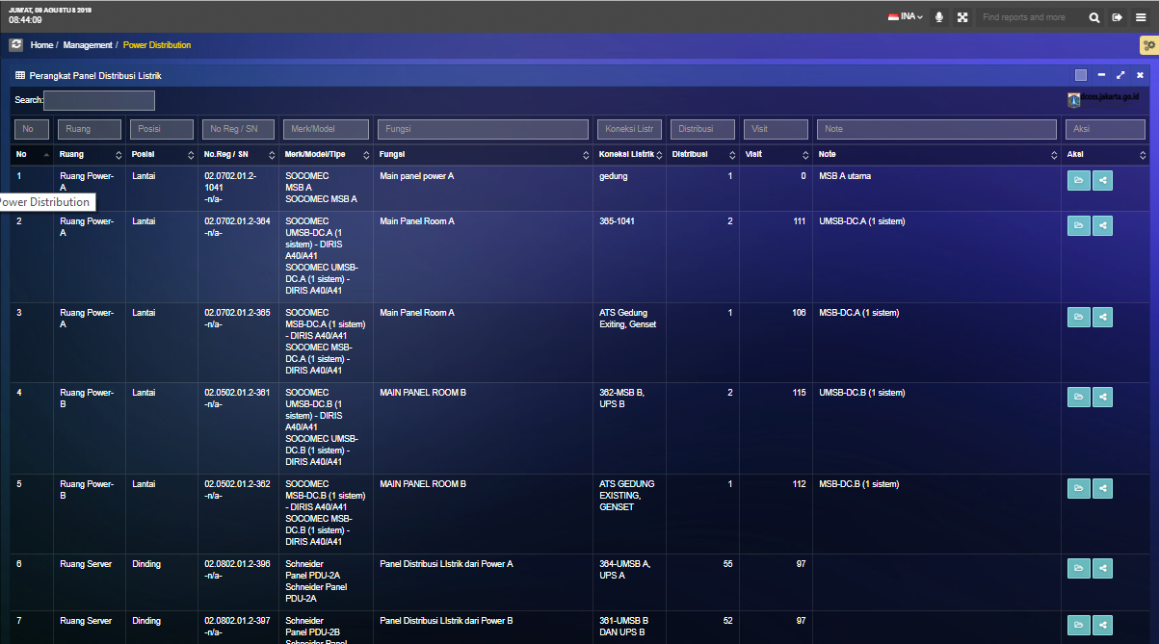
MANAGEMENT / POWER DISTRIBUTION

Slide 14
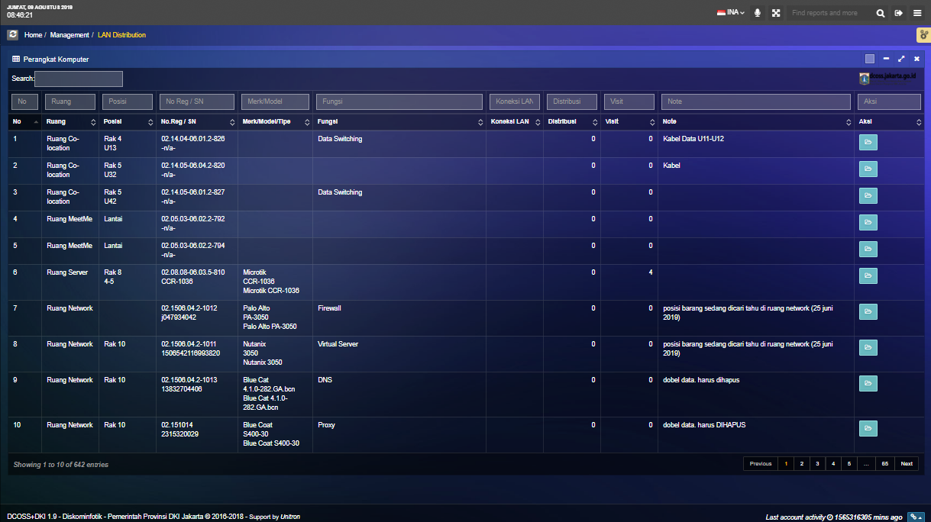
MANAGEMENT / LAN DISTRIBUTION

Slide 15
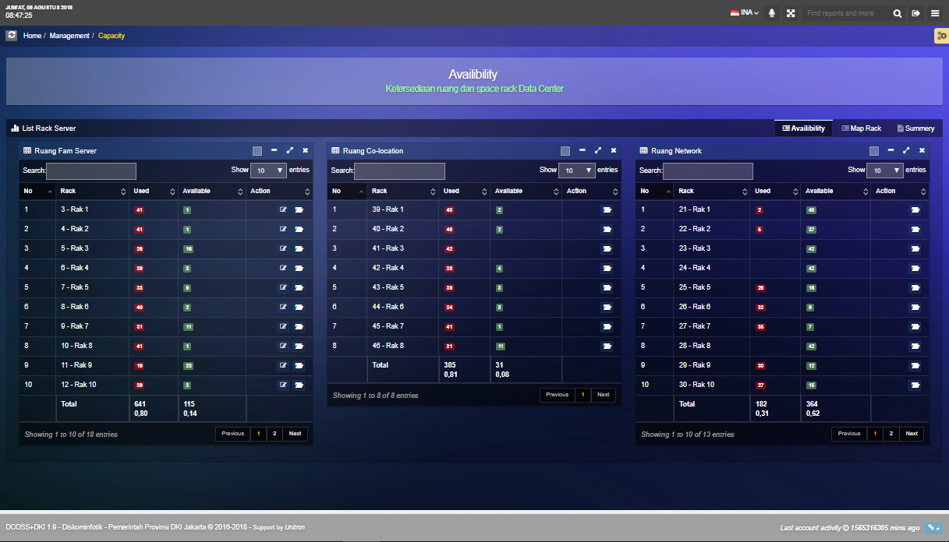
MANAGEMENT / CAPACITY

Slide 16
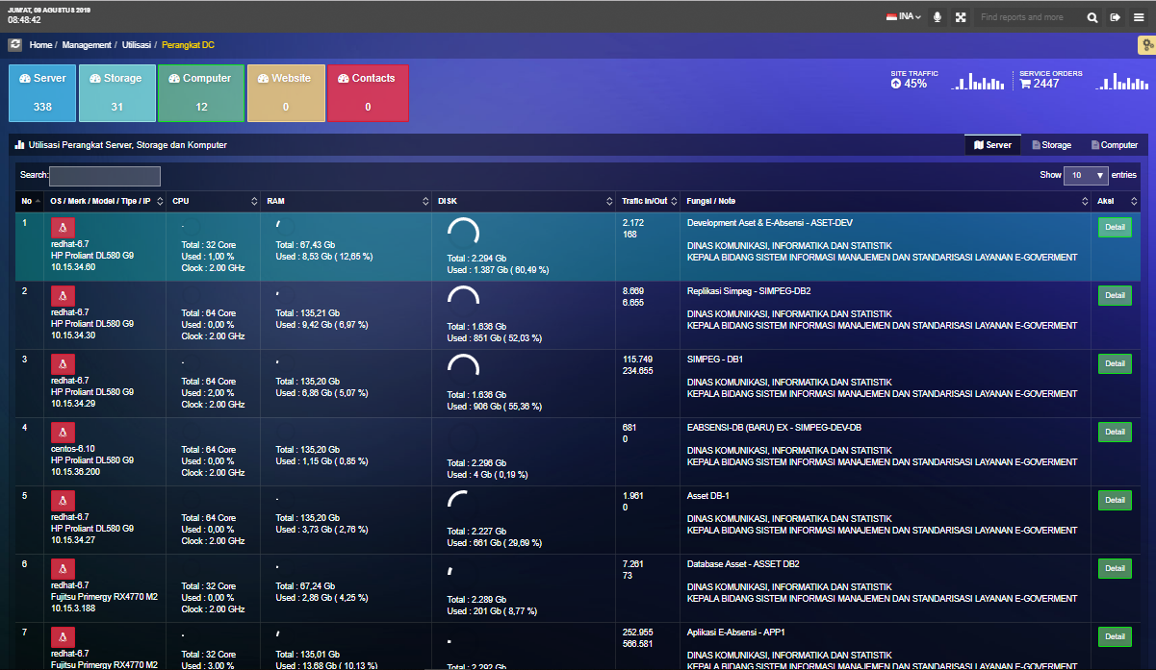
MANAGEMENT / UTILISASI / PERANGKAT DC

Slide 17
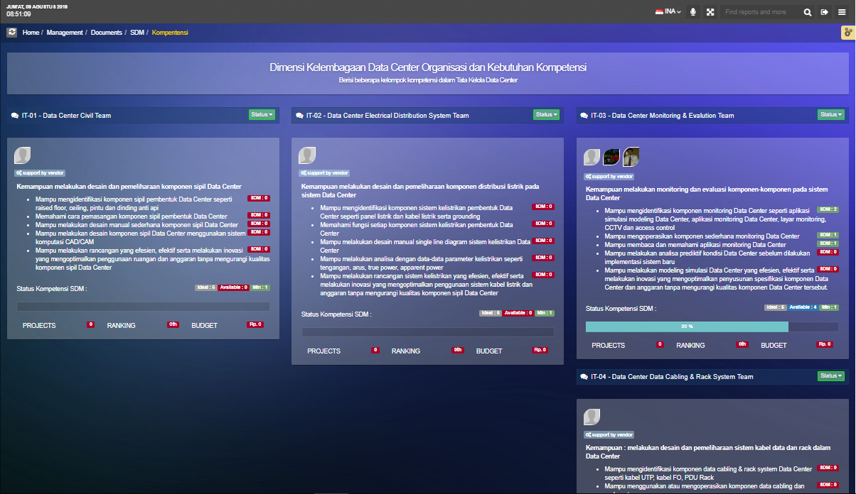
MANAGEMENT / DOCUMENT / SDM / KOMPETENSI

Slide 18
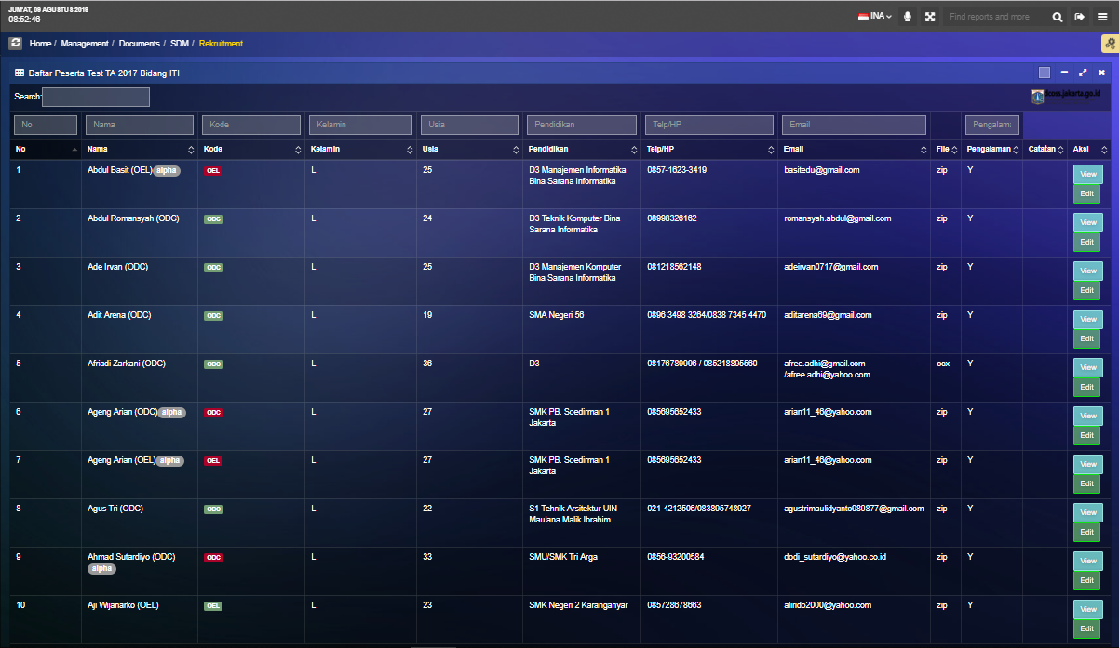
MANAGEMENT / DOCUMENT / SDM / REKRUITMENT

Slide 19
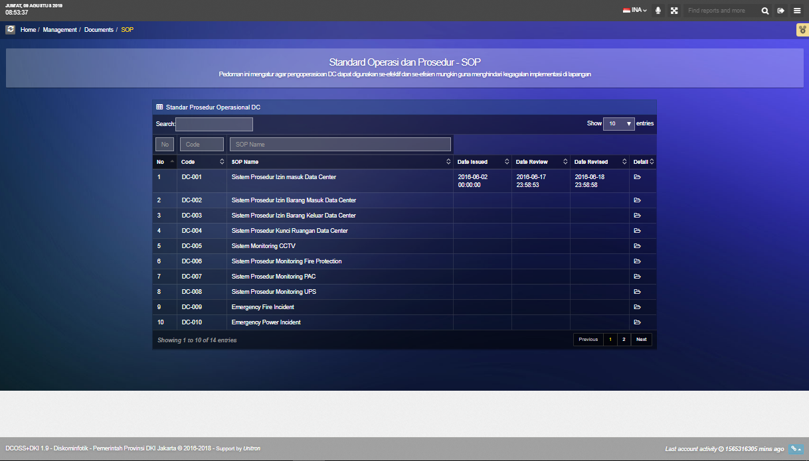
MANAGEMENT / DOCUMENT / SOP

Slide 20
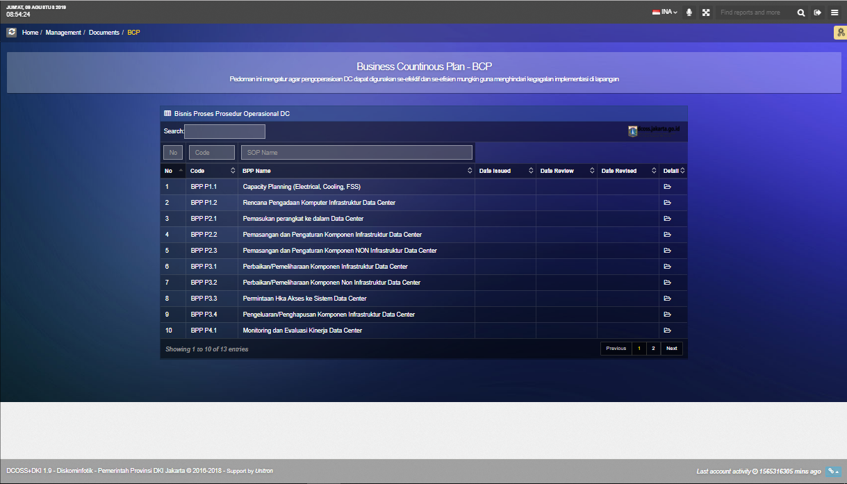
MANAGEMENT / DOCUMENT / BCP

Slide 21
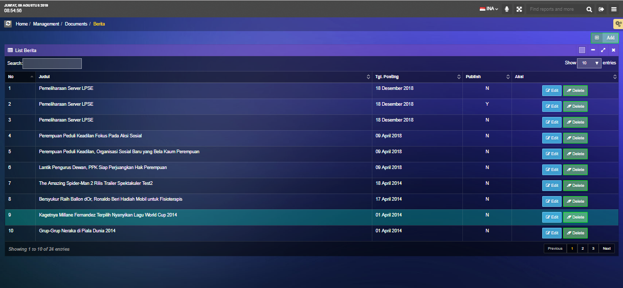
MANAGEMENT / DOCUMENT / BERITA

Slide 22
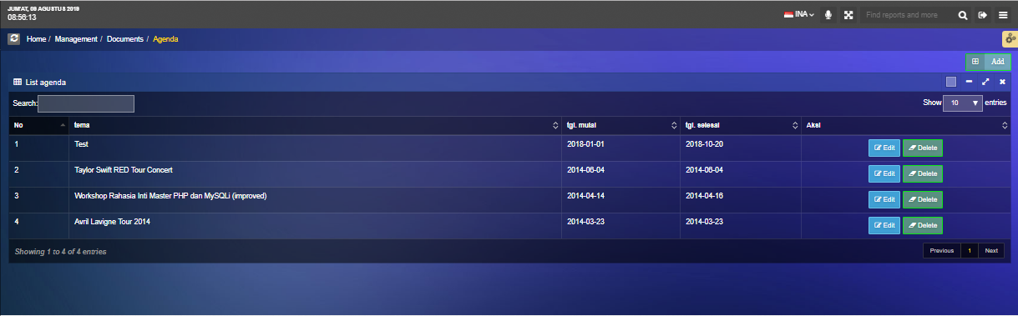
MANAGEMENT / DOCUMENT / AGENDA

Slide 23

RECORD

Slide 24
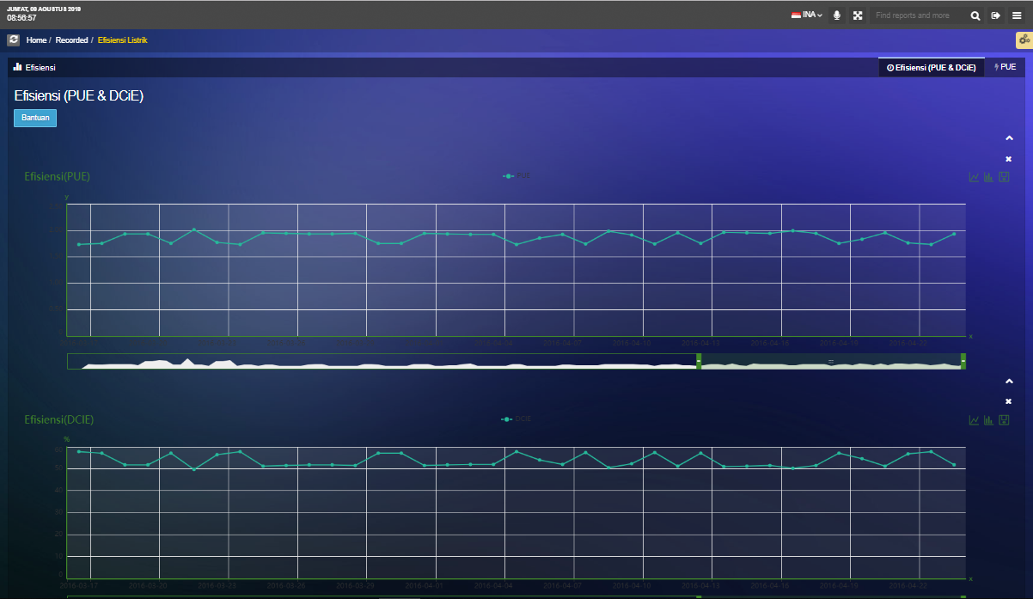
RECORDED / EFISIENSI LISTRIK

Slide 25

SETTING

Slide 26
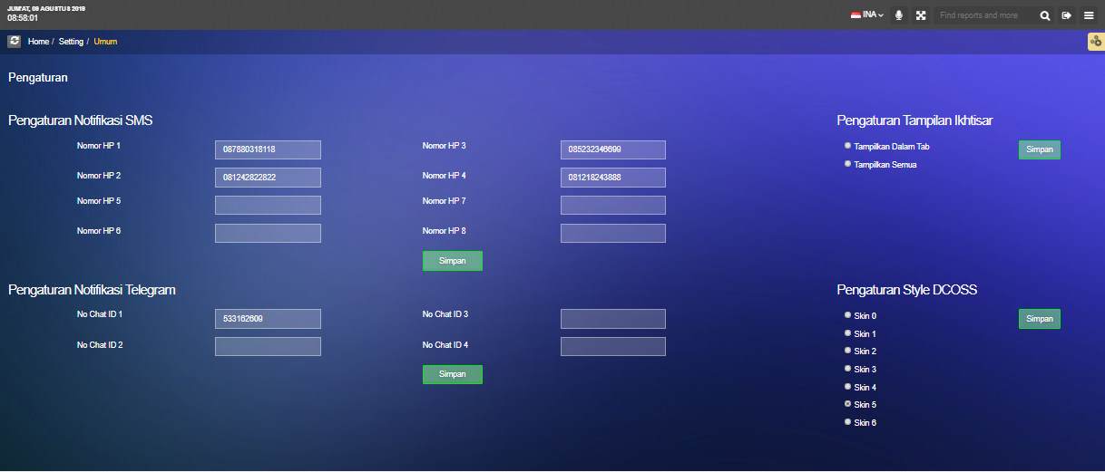
SETTING / UMUM

Slide 27
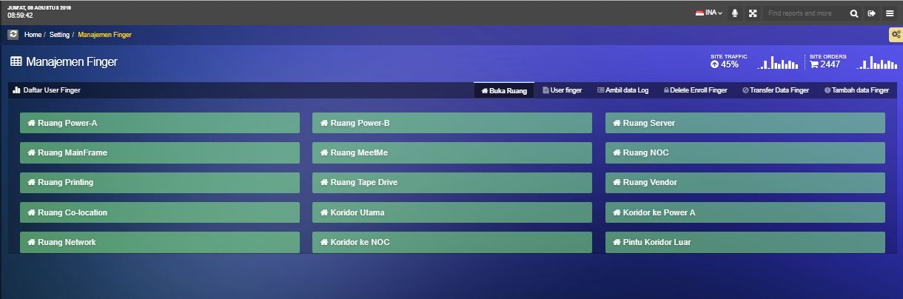
SETTING / MANAJEMEN FINGER

Slide 28
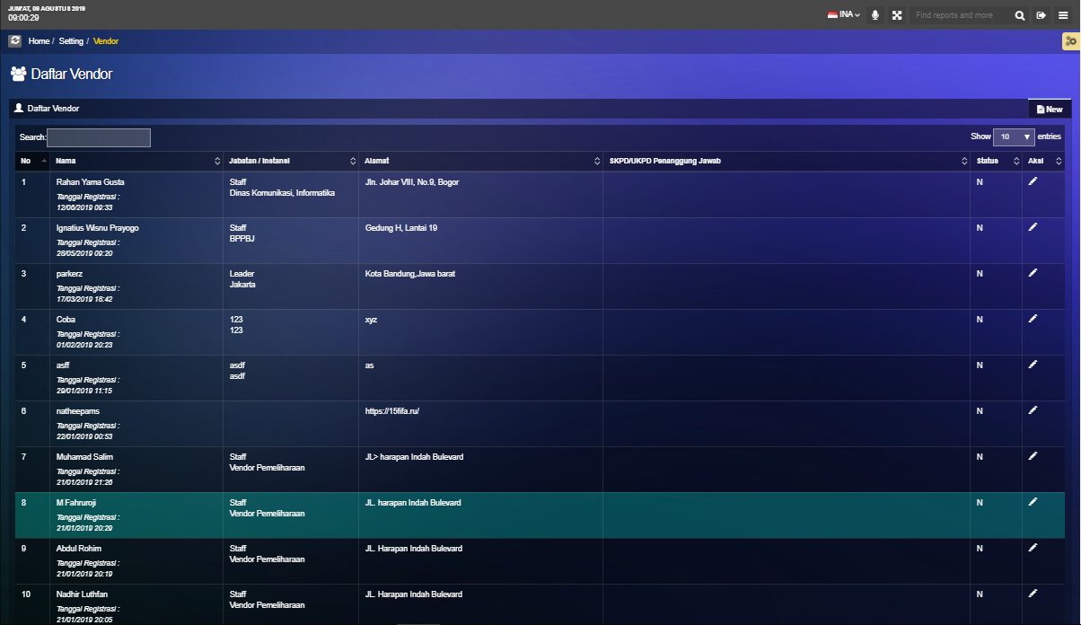
SETTING / VENDOR

Slide 29

DATA MASTER

Slide 30
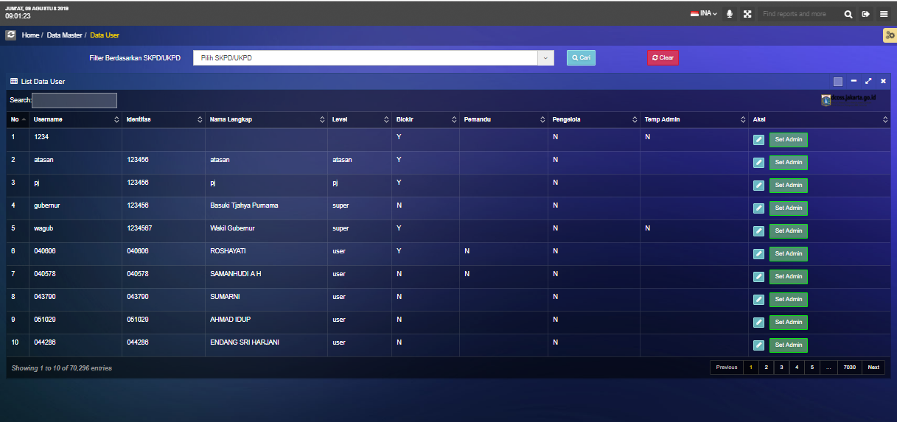
DATA MASTER / DATA USER

Slide 31
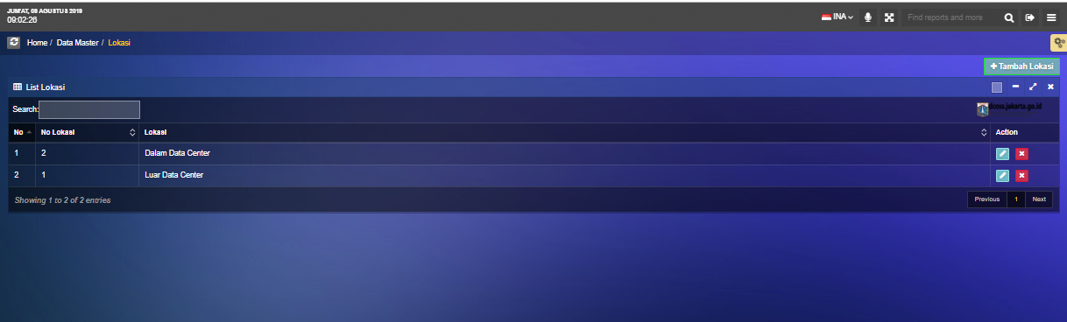
DATA MASTER / LOKASI

Slide 32
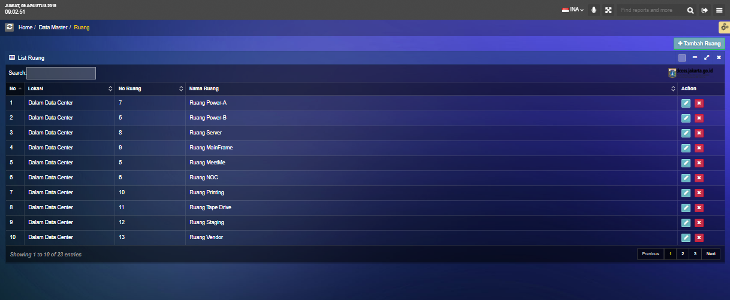
DATA MASTER / RUANG

Slide 33
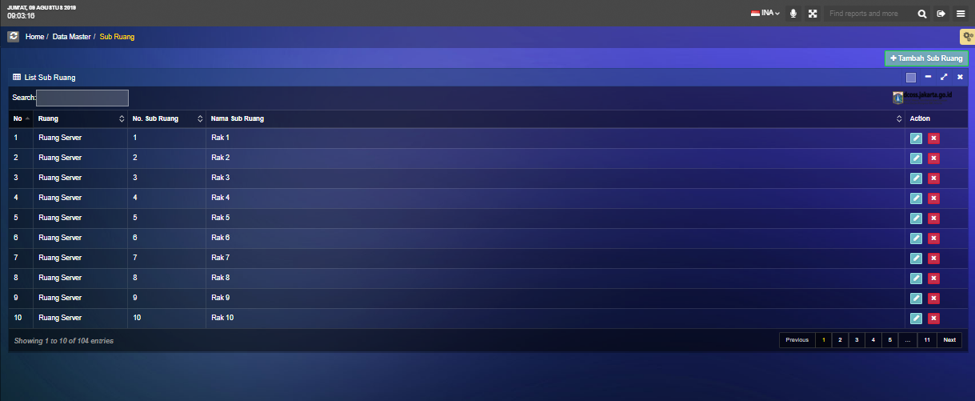
DATA MASTER / SUB RUANG

Slide 34
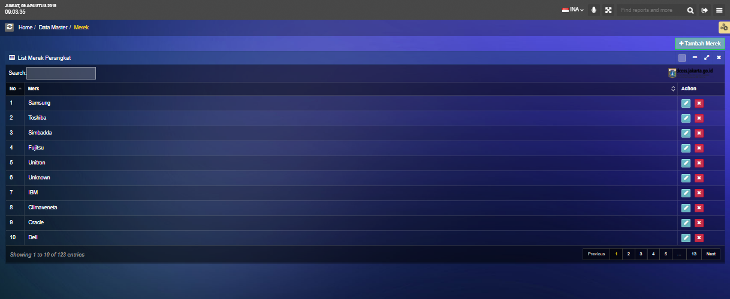
DATA MASTER / MEREK

Slide 35
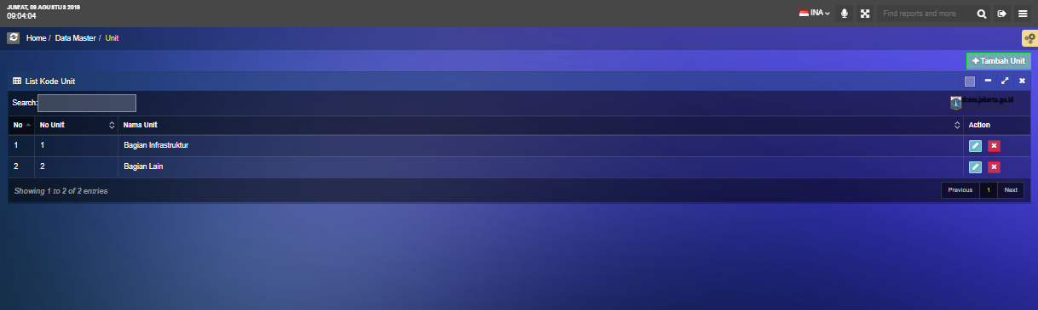
DATA MASTER / UNIT

Slide 36
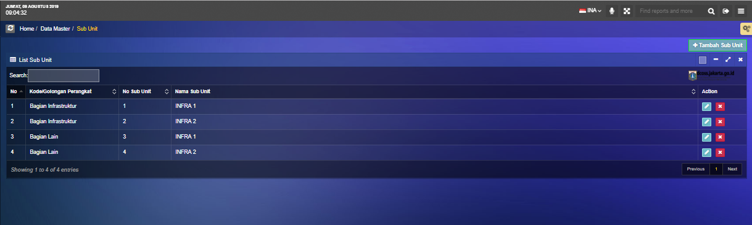
DATA MASTER / SUB UNIT

Slide 37
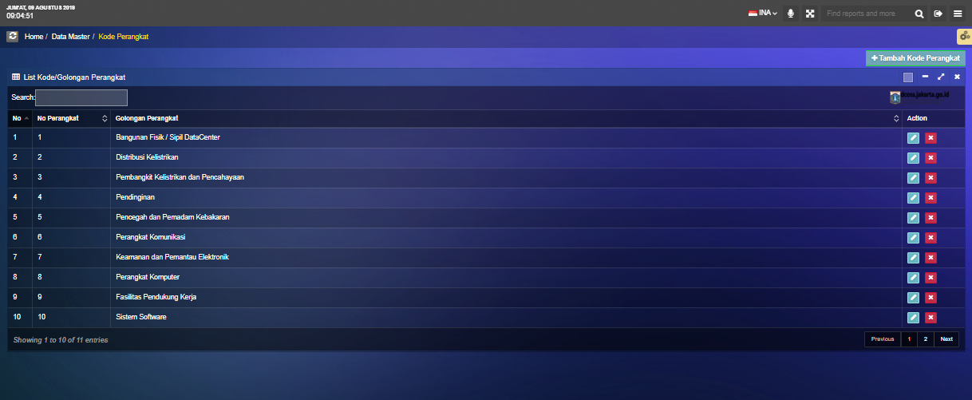
DATA MASTER / KODE PERANGKAT

Slide 38
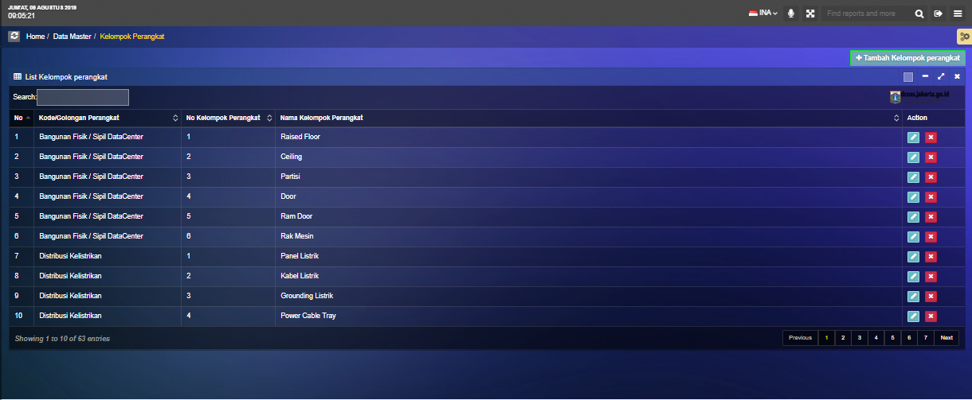
DATA MASTER / KELOMPOK PERANGKAT

